Slide 1
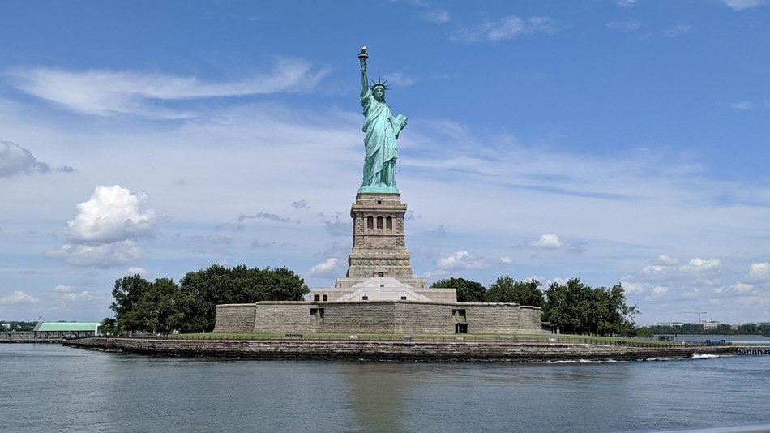
The Statue of Liberty
By Arta, Miron & Mohammad

Slide 2

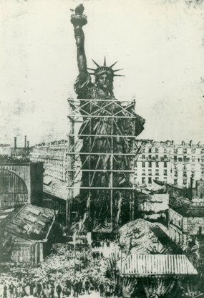
About:
The Statue of Liberty is a monument symbolizing the United States. The statue is placed on Ellis Island, near New York City Harbor. The statue commemorates the signing of the United States Declaration of Independence. It was given to the United States by the people of France in 1886, to represent the friendship between the two countries established during the American Revolution.

Slide 3

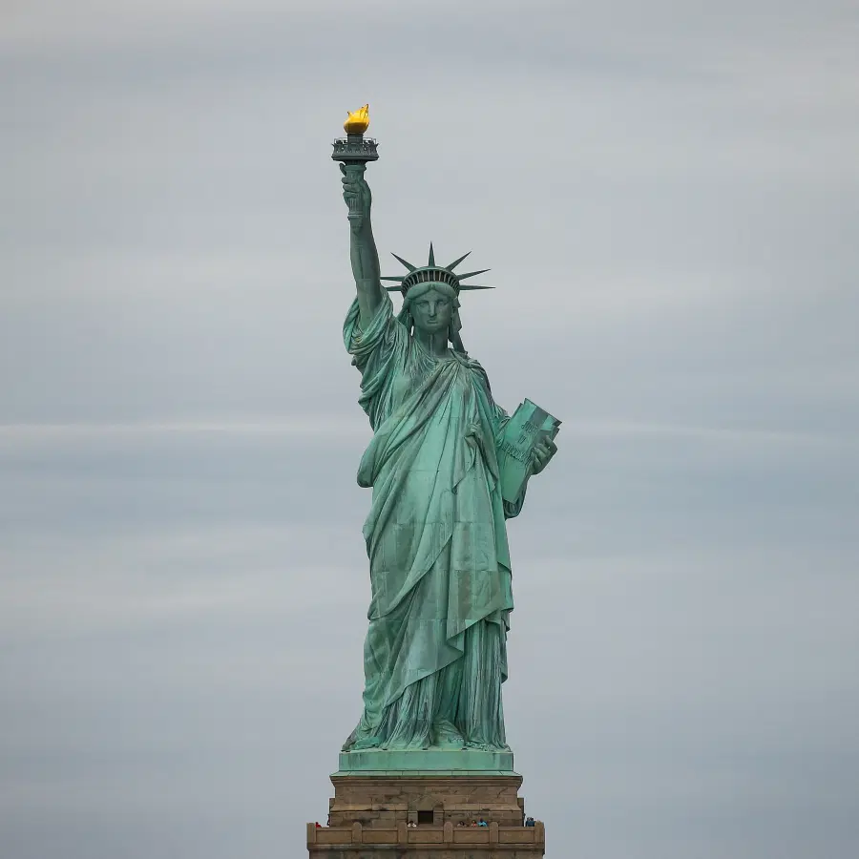
It represents a woman wearing a stola, a crown and sandals, trampling a broken chain, and with a torch in her raised right hand and a tabula ansata, or tablet where the date of the Declaration of Independence JULY IV MDCCLXXVI (1776) is written, in her left hand. The statue is on Liberty Island in New York Harbor, and it welcomes visitors, immigrants, and returning Americans travelling by ship.

Slide 4

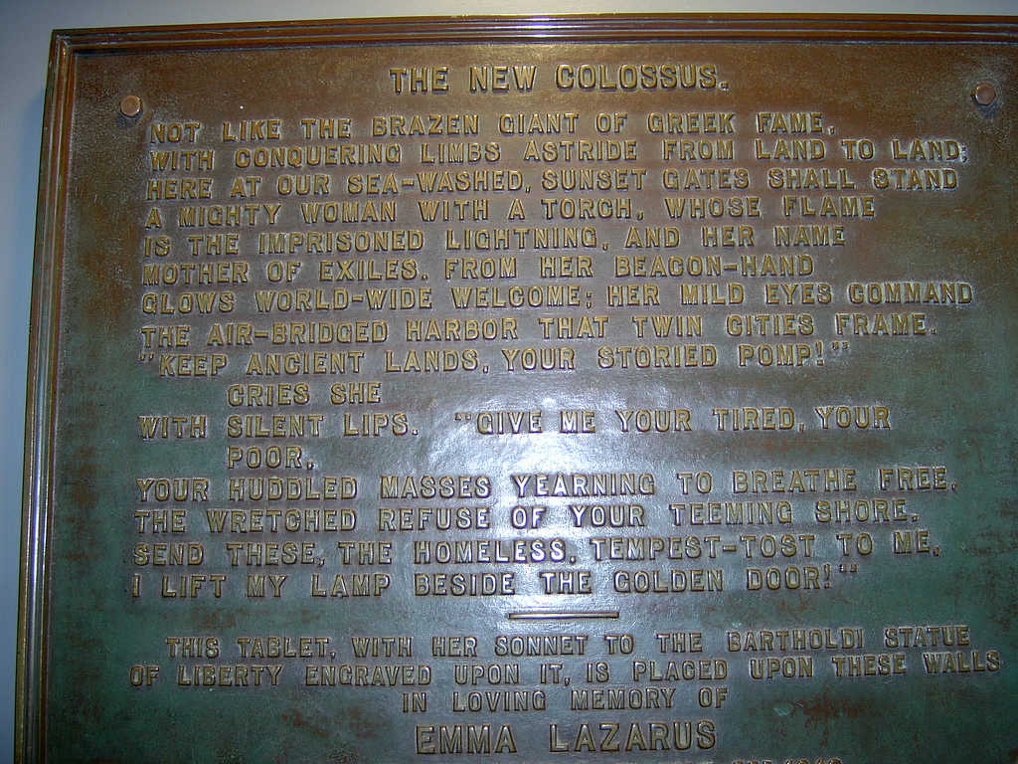
History:
Frédéric Auguste Bartholdi sculpted the statue and he obtained a U.S. patent for the structure. Maurice Koechlin, who was chief engineer of Gustave Eiffel's engineering company and designer of the Eiffel Tower, designed the internal structure. The pedestal was designed by the architect Richard Morris Hunt. Eugène Viollet-le-Duc chose copper in the construction of the statue, and for the adoption of the repoussé construction technique, where a malleable metal is hammered on the reverse side.

Slide 5

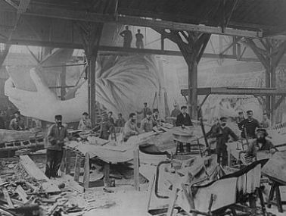
The statue is made of a covering of pure copper, left to weather to a natural blue-green patina. It has a framework of steel (originally puddled iron). The exception is the flame of the torch, which is coated in gold leaf (originally made of copper and later altered to hold glass panes). It is on a rectangular stonework pedestal. The foundation is an old star fort in the shape of an irregular eleven-pointed star. The statue is 151 ft (46 m) tall, but with the pedestal and foundation, it is 305 ft (93 m) tall.

Slide 6

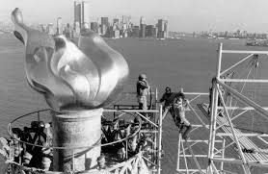
The Statue of Liberty is one of the most recognizable symbols in the world. For many years it was one of the first glances of the United States for millions of immigrants and visitors after ocean voyages from around the world.
The statue is the central part of the Statue of Liberty National Monument, administered by the National Park Service. The National Monument also includes Ellis Islan

Slide 7

The End

